Slide 1
HWA Project
SQUADBUILDER
Luxshan Puvanendrarajah

Slide 2
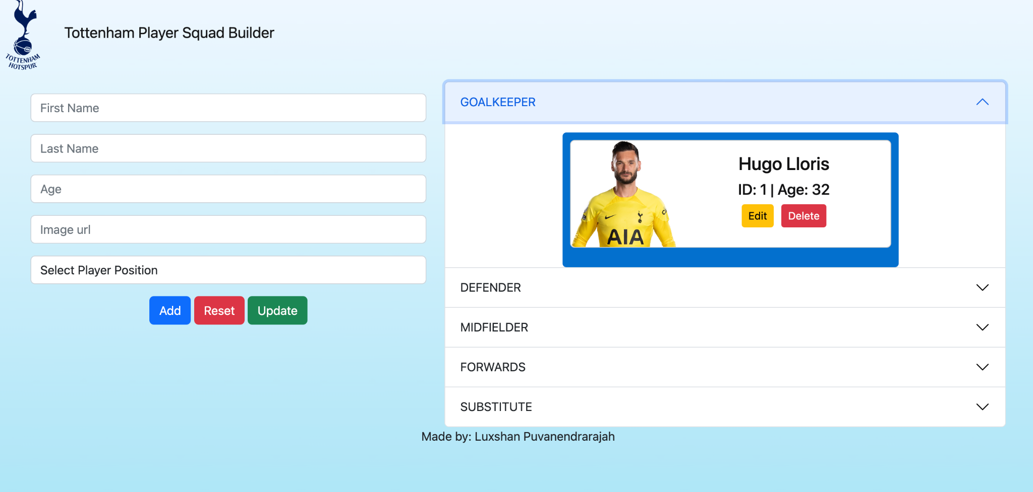
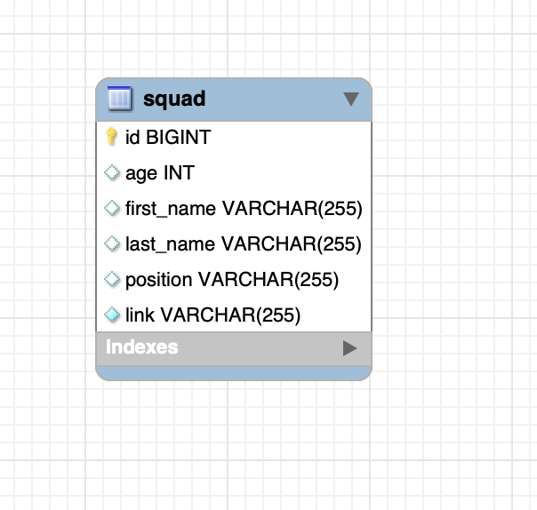
Squad builder
Hobby Project based around the football team i support.
Created using front end with html,javascript,css.
API designed using spring boot.
Backend Mysql.

Slide 3
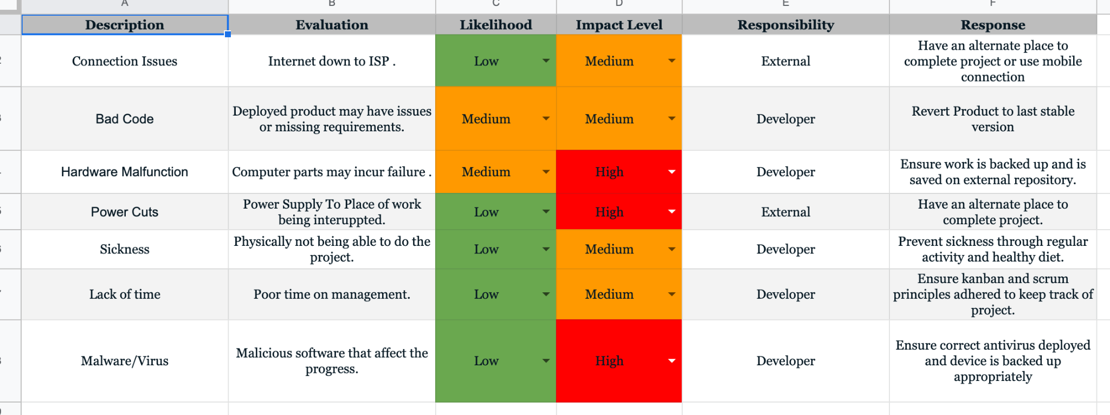
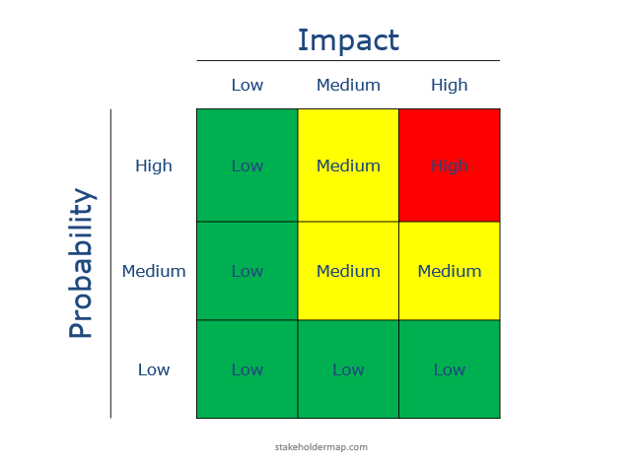
Risk Assesment

Slide 4
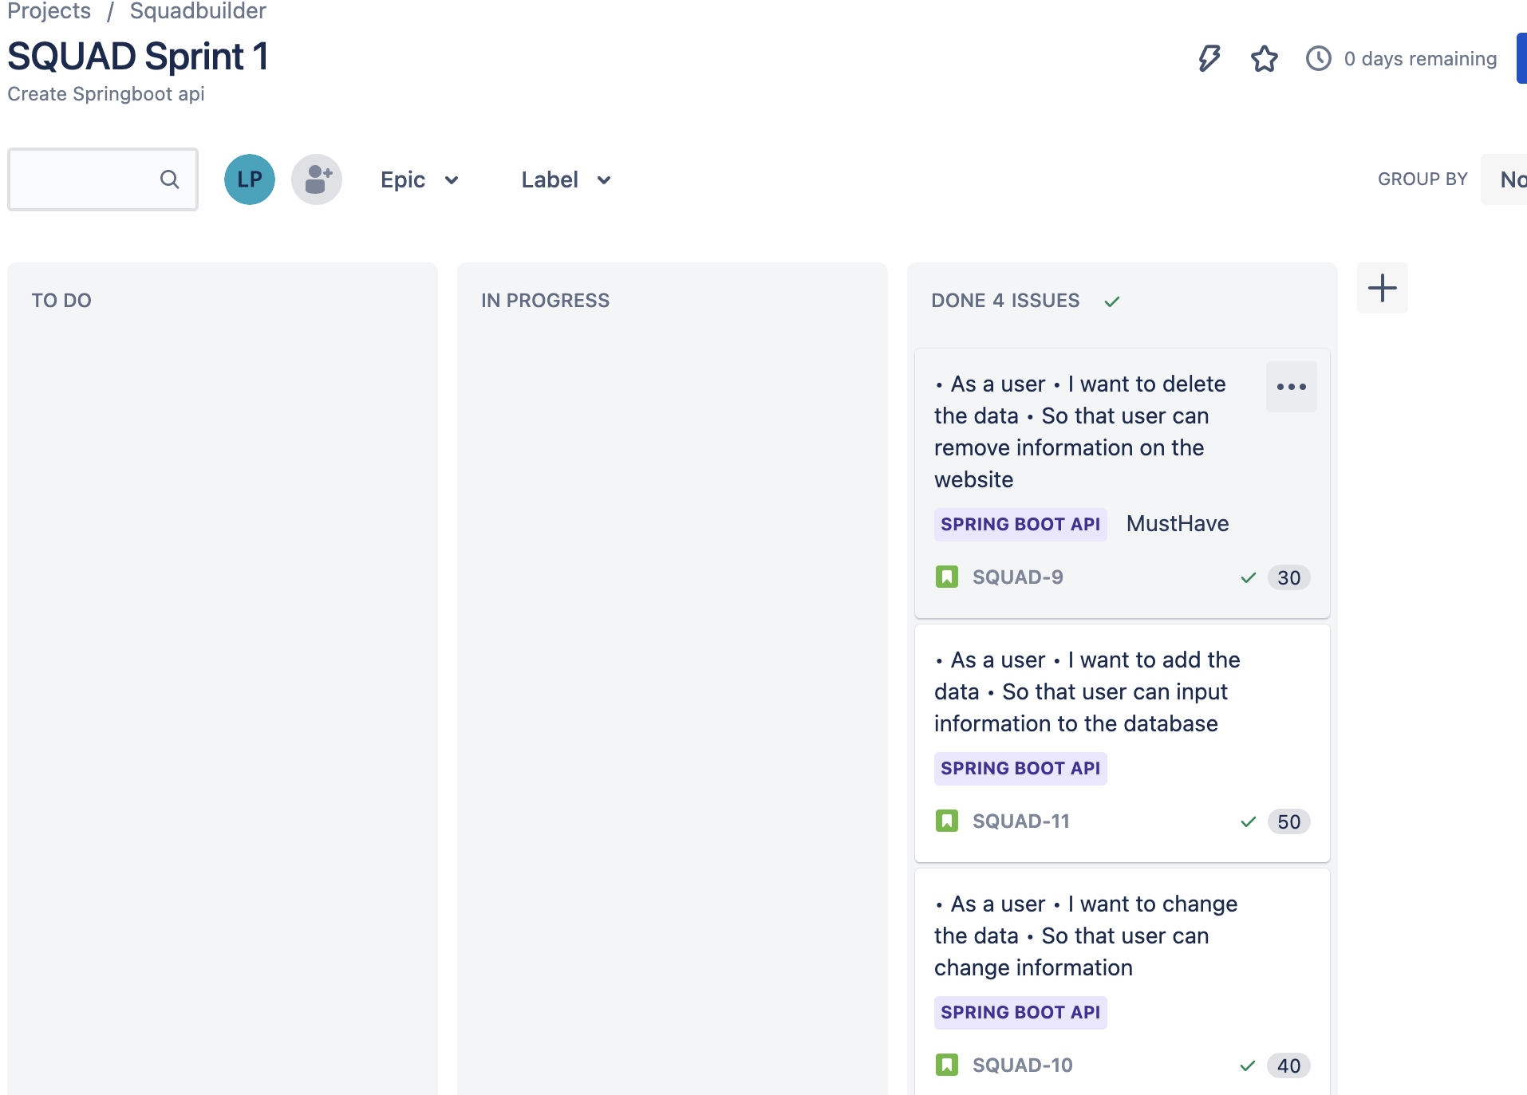
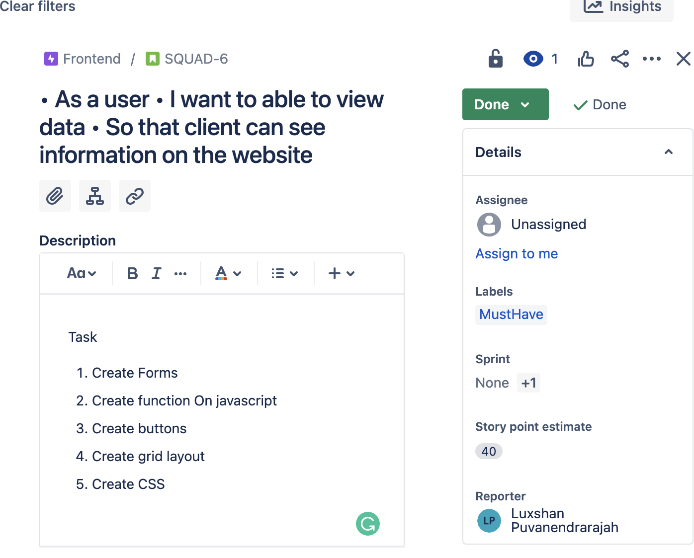
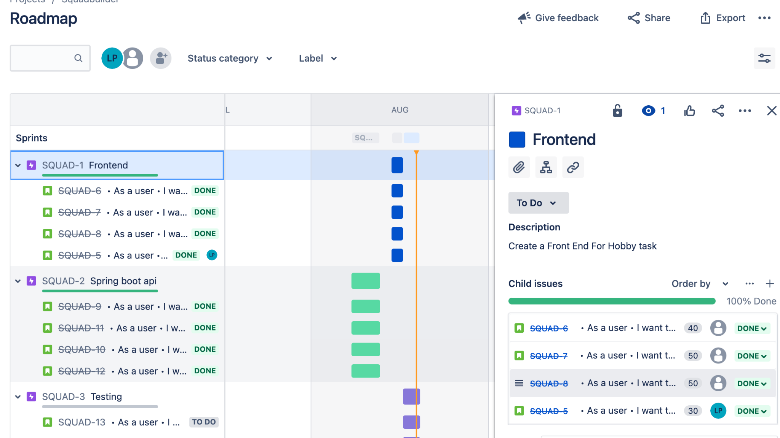
JIRA

Slide 5
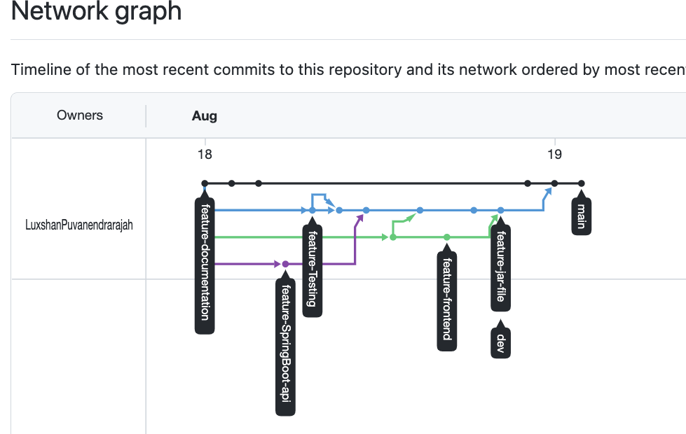
Git Hub

Slide 6
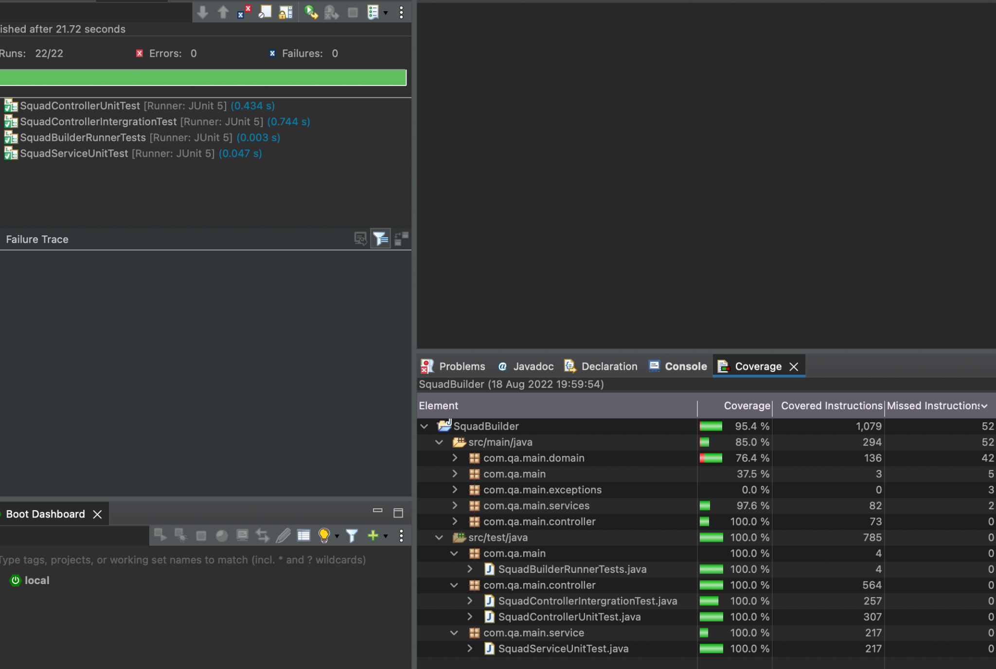
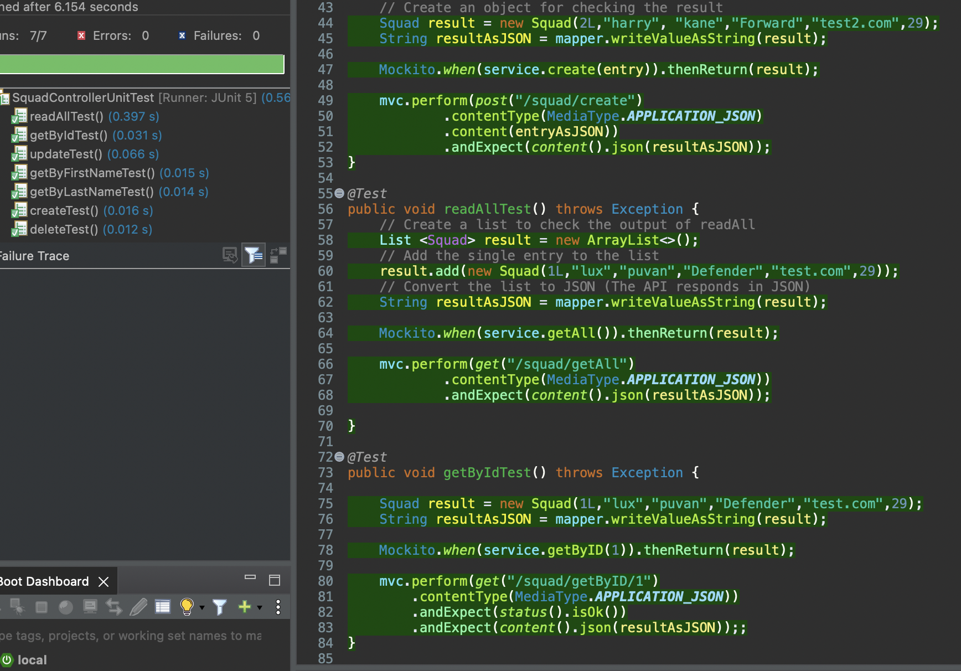
Testing

Slide 7
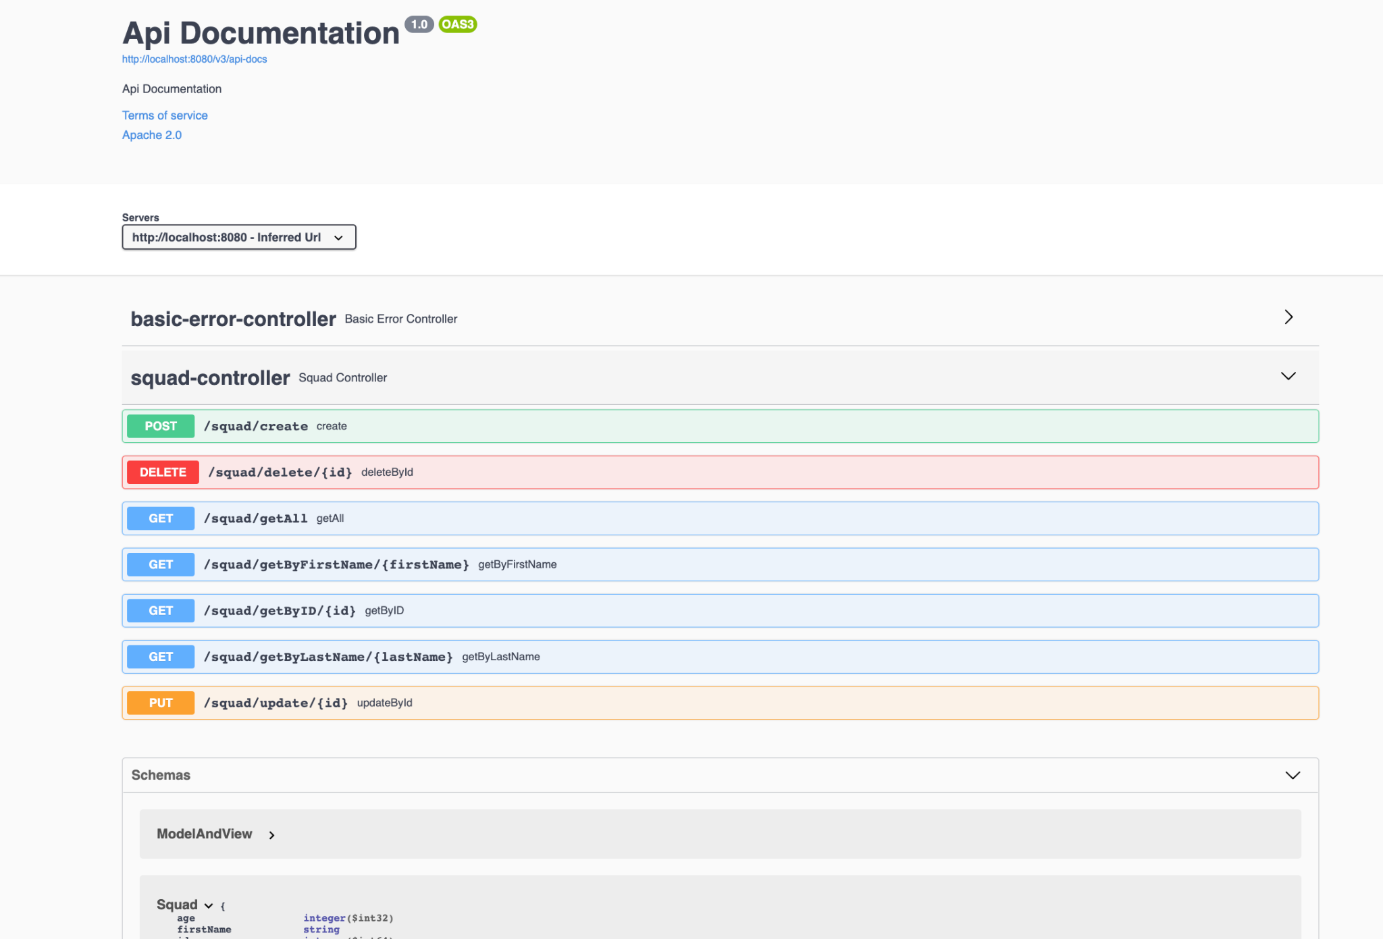
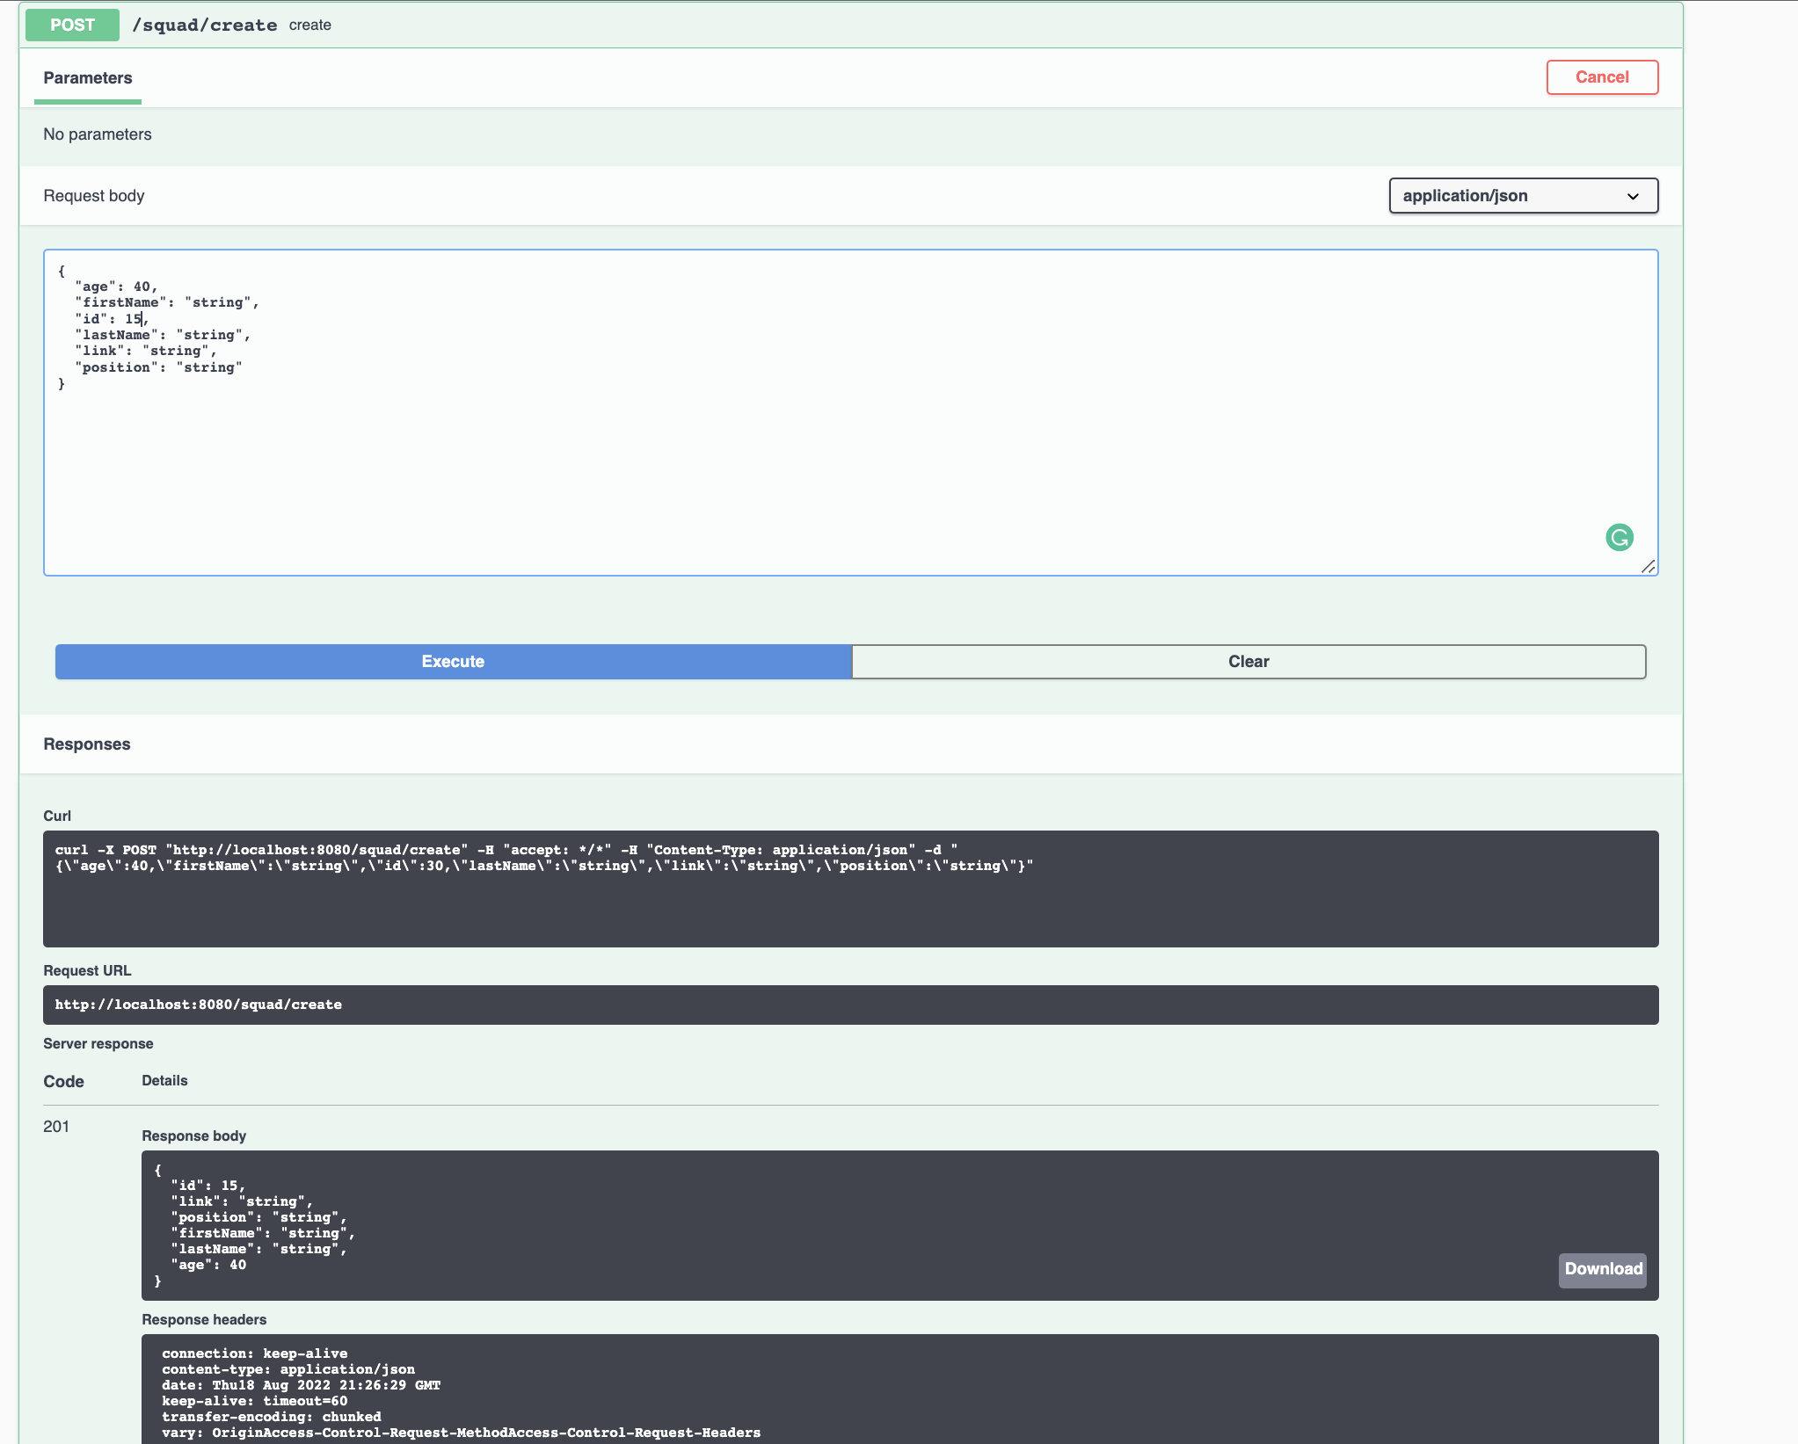
Swagger

Slide 8
Demo

Slide 9
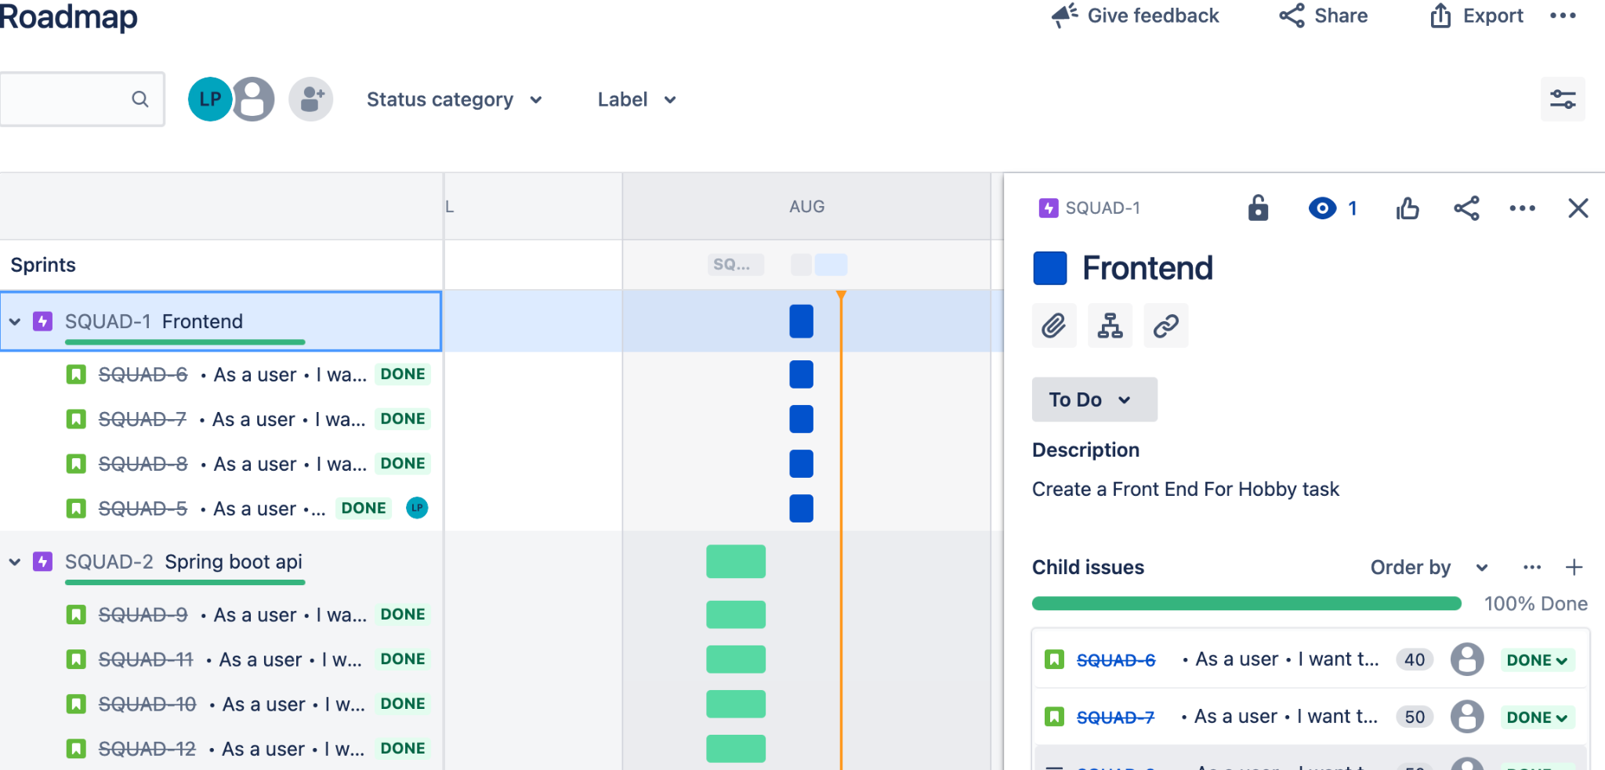
Sprint review
Sprints

Slide 10
Review
Couldn’t complete
Readme
UML diagram
Upload Documentation
Could of Done Better
Spent more time on jira
Ensure i stuck to mvp and not expand on frontend design
Ensure i complete Documentation as project progresses
Project future improvement
Have another page for login with separate database
More feature for the cards such as ratings
Enable more frontend with css 3d pitch design from codepen.io

